Slide 1
Economic Analysis of
Neonatal Hypoglycaemia
Dr Matthew Glasgow
Clinical Research Fellow, PhD Candidate

Slide 2
Background
– Neonatal Hypoglycaemia
Is a common metabolic condition; up to 50% incidence in infants with risk factors
Is frequently asymptomatic (requires screening)
Is treatable
Can have serious and/or lifelong neurological/ developmental sequelae
First described 80 years ago, but many knowledge gaps and controversies remain
Notes:
Up to 15% overall incidence, and much higher rates in those with additional risk factors (up to 50% in babies of diabetic mothers, and 66% in preterm infants).
When hypoglycaemia is identified early, and treated to maintain blood glucose > 2.6 mmol/L, there is no association with neurodevelopment at 2 years of age.

Slide 3

Background
– Neonatal Hypoglycaemia
Initial management of neonatal hypoglycaemia is administration of supplemental carbohydrate
NICU admission for intravenous dextrose is indicated if oral carbohydrate not tolerated or not effective
Sugar Babies Study showed dextrose gel treatment (when compared to placebo):
Is well tolerated
Had fewer instances of treatment failure
Had fewer admissions to NICU for hypoglycaemia
Harris DL, Weston PJ, Signal M, Chase JG, Harding JE. Dextrose gel for neonatal hypoglycaemia (the Sugar Babies Study): a randomised, double-blind, placebo-controlled trial. Lancet. 2013;382:2077-83.

Slide 4
Background
– Neonatal Hypoglycaemia
Neonatal hypoglycaemia is associated with financial and societal costs (management and sequelae)
Burden of hypoglycaemia is not well documented
Economic evaluations are important components in the effective uptake of health research findings
Notes:
60,000 annual births … NICU: 10% admission rate in New Zealand in this population, ~2,100 newborn/year, mean length of admission to NICU of 3 days, initial treatment costs could total $9.4 million per year in direct NICU costs alone.
Cost-effectiveness evaluations and health technology assessments are important components in the effective uptake of health research findings

Slide 5
PhD Thesis
A series of economic analyses examining the lifetime burden of neonatal hypoglycaemia and costs +/- utilities associated with aspects of its management.
Costs of glucometer screening methods
Costs of dextrose gel for treatment
Decision tree model of neonatal hypoglycaemia
Economic analysis of neonatal hypoglycaemia
Cost-utility of hypoglycaemia prophylaxis
Identification of knowledge/information gaps
Cost-utility of changing practice/implementing new guidelines

Slide 6
Cost analysis of cot-side screening methods for neonatal hypoglycaemia
Glasgow MJ, Harding JE, Edlin R (2018). "Cost Analysis of Cot-Side Screening Methods for Neonatal Hypoglycaemia." Neonatology 114(2): 155-162.

Slide 7
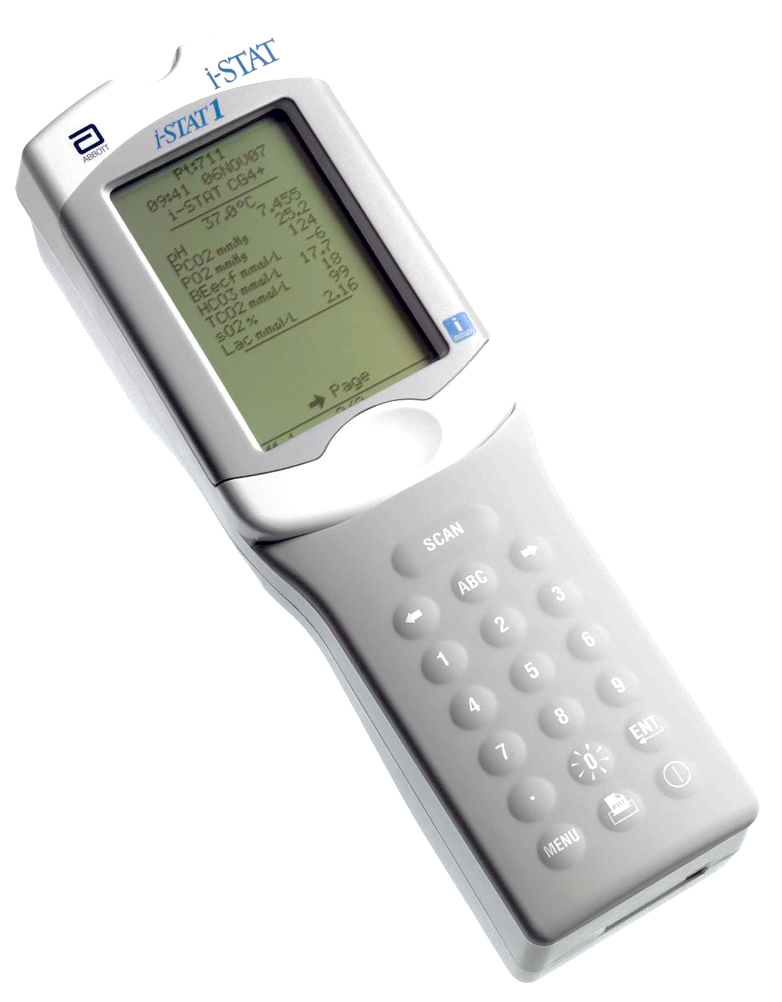
Background
- Glucometers
What is the overall cost of, and cost difference between, non-enzymatic and enzymatic glucometers?
Notes:
Research question:
What is the overall cost of, and cost difference between, non-enzymatic glucometers, which require abnormal results to be verified by laboratory testing, to enzymatic glucometers, which can directly inform management without re-testing

Slide 8
Methods
- Probabilities and Costs
Incidence data from Sugar Babies Study
Costs include consumables and staff time
Costs in NZ dollars with base year of 2015/16
Harris DL, Weston PJ, Harding JE. Incidence of neonatal hypoglycemia in babies identified as at risk. J Pediatr 2012;161(5):787-91.
Notes:
Glucose concentration threshold of 2.6 mmol/L.
Incidence data used to model the proportions of at-risk infants who develop neonatal hypoglycemia was extracted from the raw data from the Sugar Babies Study.
Sugar Babies Study - recruited infants at risk of hypoglycemia (late preterm (35-37 weeks of gestation), small (< 10th percentile or < 2500 g), large (> 90th percentile or > 4500 g), mother with diabetes, or other), and used a threshold for definition of hypoglycemia of 2.6 mmol/L.
Consumables include reagents involved in the analysis, which in handheld devices are incorporated into a strip or cartridge, the lancet used to draw blood from the heel of the infant, and capillary tubes used in the collection of the blood sample for analysis by enzymatic-reaction-based glucometers.
Staff time includes an estimate of time for sample collection, and is slightly longer with enzymatic glucometers because blood is collected in a capillary tube before being applied to an analyte cartridge or card attached to the test device, whereas in the non-enzymatic methods blood drawn from a heel prick can be directly applied to a test strip.
Staff costs are based on an hourly rate equivalent to the top of the salary range for a senior registered nurse or midwife (step 5)

Slide 9
Glucose above threshold on all screens
Glucose above threshold
Enzymatic glucometer screening
Glucose below threshold on subsequent screen
Glucose below threshold
Glucose above threshold on all screens
Glucose above threshold
Glucose below threshold on subsequent screen
Non-enzymatic glucometer screening
Not confirmed by enzymatic test; treated
Glucose below threshold
Enzymatic test confirmation
Notes:
A choice is presented between initial screening of infants at risk of neonatal hypoglycaemia using either an enzymatic or a non-enzymatic point-of-care blood glucose analyser.
At the initial testing, glucose concentration is recorded above or below the diagnostic threshold.
Enzymatic point-of care devices use the glucose oxidase test, which is considered a gold standard; thus if results are below the threshold the infants enter treatment for neonatal hypoglycaemia.
For non-enzymatic point-of-care tests, a result below the threshold may be either confirmed by laboratory testing (as per protocol) or treatment may proceed without additional testing (deviation from protocol).

Slide 10
Results
- Base Analysis
Mean number of tests performed
  6.0 if all measurements below threshold
  11.1 first measurement above threshold
  7.0 initial measurement below, but subsequent measurements above threshold
Screening costs per infant
  $86.94 with enzymatic glucometer
  $97.08 with non-enzymatic glucometer
Notes:
The primary analysis involves the scenario where approximately half (52%) of at risk infants develop hypoglycaemia with one third (33%) doing so at the time of their first screening test, and the remainder (19%) on the next test after a single normal screening test.
The mean number of blood glucose tests performed was:
6.0 in at risk infants who did not have any blood glucose concentration measurements below the threshold,
11.1 in infants whose first measurement was above the threshold but who had one or more measurements below the threshold on any subsequent test,
and 7.0 in infants with an initial blood glucose concentration measurement below the threshold and with any value on subsequent tests.
If non-enzymatic glucometer testing is assumed to be accurate and all measurements that are low by non-enzymatic testing are confirmed by laboratory testing, then screening using an enzymatic glucometer costs NZ$86.94 while screening using a non-enzymatic glucometer but with laboratory confirmation of low results costs NZ$97.08 per infant screened.

Slide 11
Discussion
Use of an enzymatic glucometer to screen for and inform treatment of neonatal hypoglycaemia costs less than screening with a non-enzymatic device
Reducing invasive procedures may have benefits
False-positives and overtreatment have implications for cost and outcome
False-negatives (missed diagnoses) may have long-term health implications
Notes:
Use of a more accurate enzymatic glucometer to screen for neonatal hypoglycaemia and inform its treatment results in cost savings compared to using a non-enzymatic glucometer that requires laboratory confirmation of low blood glucose concentrations under usual conditions.
Non-enzymatic glucometers are often used to screen for neonatal hypoglycaemia because of their availability and familiarity.
The initial purchase price and cost of ongoing use of enzymatic glucometers are commonly cited as reasons for persisting with non-enzymatic glucometers as a screening device.
However, that does not take in to account either the immediate implications of using a screening method with a level of accuracy that requires re-testing to verify abnormal results, nor the long-term repercussions of failing to identify and treat cases of hypoglycaemia.
The requirement for additional blood sampling to confirm low results also increases the number of invasive procedures performed on the newborn infant and may delay treatment where confirmation is required by laboratory testing.
In addition, false positive results from imprecise screening devices can result in overtreatment, thus increasing costs as well as separating the infant from its mother, and interfering with the establishment of breastfeeding.
Non-enzymatic glucometers are widely used to screen for neonatal hypoglycaemia.
It is hard to imagine another scenario in medicine where screening to guide diagnosis and management of a brain-threatening condition is commonly undertaken using an instrument known to be inaccurate and requiring abnormal results to be repeated, and is justified primarily on the basis of apparently lower postnatal ward costs.
Our analysis shows that even under conservative conditions, a screening approach using enzymatic glucometers is likely to have lower direct costs, and also avoids the longer term risks and costs associated with false positive and false negative results.
In view of their lower cost under most circumstances and greater accuracy, enzymatic glucometers should be routinely utilised for point-of-care screening for neonatal hypoglycemia.

Slide 12
Cost Analysis of Dextrose Gel for Treating Neonatal Hypoglycaemia
Glasgow MJ, Harding JE, Edlin R (2018). "Cost Analysis of Treating Neonatal Hypoglycemia with Dextrose Gel." J Pediatr.

Slide 13
Methods
Hypoglycaemia
40% Dextrose Gel
Single Episode Hypoglycaemia
Recurrent Hypoglycaemia
Placebo
Admitted to NICU
Not Admitted to NICU
Admitted to NICU
Not Admitted to NICU
Single Episode Hypoglycaemia
Admitted to NICU
Not Admitted to NICU
Recurrent Hypoglycaemia
Admitted to NICU
Not Admitted to NICU
Notes:
Our decision tree model contains both arms of the Sugar Babies Study (that is, the dextrose gel arm, and the placebo arm), and, is set up to capture the proportions of hypoglycaemic infants who had a single episode versus those that experienced recurrent hypoglycaemia. Both arms received other usual care, so the placebo arm can be thought of as representing “feeding alone”.
72 words, 35 seconds

Slide 14
Methods
- Probabilities and Costs
Short-term hospital costs
Costs considered from postnatal ward, NICU, screening & monitoring, and therapy
Ward/bed occupancy costs extracted from Sugar Babies Study and hospital records
Harris DL, Weston PJ, Harding JE. Incidence of neonatal hypoglycemia in babies identified as at risk. J Pediatr 2012;161(5):787-91.
Notes:
Glucose concentration threshold of 2.6 mmol/L.
Incidence data used to model the proportions of at-risk infants who develop neonatal hypoglycemia was extracted from the raw data from the Sugar Babies Study.
Sugar Babies Study - recruited infants at risk of hypoglycemia (late preterm (35-37 weeks of gestation), small (< 10th percentile or < 2500 g), large (> 90th percentile or > 4500 g), mother with diabetes, or other), and used a threshold for definition of hypoglycemia of 2.6 mmol/L.
Consumables include reagents involved in the analysis, which in handheld devices are incorporated into a strip or cartridge, the lancet used to draw blood from the heel of the infant, and capillary tubes used in the collection of the blood sample for analysis by enzymatic-reaction-based glucometers.
Staff time includes an estimate of time for sample collection, and is slightly longer with enzymatic glucometers because blood is collected in a capillary tube before being applied to an analyte cartridge or card attached to the test device, whereas in the non-enzymatic methods blood drawn from a heel prick can be directly applied to a test strip.
Staff costs are based on an hourly rate equivalent to the top of the salary range for a senior registered nurse or midwife (step 5)

Slide 15
Results
Hypoglycaemia
(n=237)
40% Dextrose Gel
(n=118)
Single Episode Hypoglycaemia
(n=76, 64.4%)
Recurrent Hypoglycaemia
(n=42, 35.6%)
Placebo
(n=119)
Admitted to NICU
(n=25, 21.2%)
Not Admitted to NICU
(n=51, 43.2%)
Admitted to NICU
(n=20, 16.9%)
Not Admitted to NICU
(n=22, 18.6%)
Single Episode Hypoglycaemia
(n=76, 63.9%)
Admitted to NICU
(n=32, 26.9%)
Not Admitted to NICU
(n=44, 37.0%)
Recurrent Hypoglycaemia
(n=43, 36.1%)
Admitted to NICU
(n=20. 16.8%)
Not Admitted to NICU
(n=23, 19.3%)
Notes:
The main aim of this study is to compare the costs in the dextrose gel arm of this model against the placebo arm of the model. The costs of each arm are the sum of the products of the proportions in each group and their average costs of hospital stay. For example, in the dextrose gel arm we know the average cost of hospital stay for patients with a single episode of hypoglycaemia who were admitted to NICU, or who were not admitted to NICU, respectively, and so on, and the total cost for the dextrose arm is the sum across these four groups, taking into account the proportions in each group.
We also used a bootstrap approach in each analysis we performed, which involved drawing 10,000 samples with replacement from the original dataset of 237 hypoglycaemic infants, in order to estimate the standard deviation of each calculated cost and cost difference.
144 words, 70 seconds

Slide 16
Results
Scenario | Dextrose Gel (SD) | Placebo (SD) | Difference (SD)
Base case | $6,863 ($345) | $8,178 ($411) | $1,314 ($535)
Notes:
In our base analysis, for the dextrose gel arm, our modelling calculated a cost of $6,863 for a single patient with hypoglycaemia, compared with a cost of $8,178 if that patient were initially treated with standard care/increased feeding only. That is a cost difference of $1,314 per patient in favour of initial treatment with dextrose gel.
Within the bootstrapped sample, dextrose gel cost less than placebo in more than 99% of the 10,000 resampled runs.

Slide 17
Results
Scenario | Dextrose Gel (SD) | Placebo (SD) | Difference (SD)
Base case | $6,863 ($345) | $8,178 ($411) | $1,314 ($535)
Caesarean section rate reduced to 20% | $6,125 ($317) | $7,713 ($431) | $1,587 ($538)
Dextrose gel dose cost reduced to $1.29 Maximum doses per container | $6,803 ($347) | $8,156 ($406) | $1,352 ($539)
Dextrose gel dose cost increased to $86 Single dose per container | $6,974 ($347) | $8,178 ($408) | $1,204 ($539)
NICU cost per day decreased to $1,100 | $5,798 ($229) | $6,464 ($254) | $665 ($344)
NICU cost per day increased to $3,200 | $7,767 ($460) | $9,698 ($568) | $1,931 ($725)
Notes:
Because modelling of this type is only a proxy for reality, with a number of simplifications required to make the model pragmatic and usable, we also performed a range of sensitivity analyses to test that those simplifications weren’t having an impact on our base analysis results. Our sensitivity analyses included varying such parameters as the Caesarean section rate (which, in our Sugar Babies sample is higher than the national average), and the primary pricing components. The greatest variance in the cost difference came with the varying the NICU cost per day parameter – because it is that variable that had the greatest contribution to the overall cost difference between the modelled patient groups.
Dextrose gel remains cost saving, however, even when NICU daily costs are reduced to an unfeasibly low level of about $100/day.

Slide 18
Discussion
Use of dextrose gel resulted in cost savings compared to usual care
Majority of difference in cost due to proportion admitted to NICU and length of stay
Costs savings persist independent of dextrose gel-related costs
Study limitation: data from single site; variance may exist with different treatment and/or NICU admission protocols
Notes:
In summary, the use of dextrose gel resulted in cost savings compared to usual care.
The Sugar Babies Study found that infants who received dextrose gel were less likely to be admitted to NICU for hypoglycaemia, less likely to receive additional dextrose, and less likely to experience treatment failure. In our analysis, most of the difference in the overall costs between the two treatment arms arises from those infants admitted to NICU for hypoglycaemia.
Dextrose gel, on the other hand, contributes only a small proportion of the total costs of care, and hence its use remains the less costly treatment regardless of variations in the cost per dose.
It is noteworthy that our study is based on data from a single, large site. This has advantages and disadvantages – results may vary in scenarios where different treatment protocols, particularly NICU admission protocols, guide or govern practice.
Before this study we knew that…
Dextrose gel is effective, well tolerated by infants, easy to administer including by parents, and is inexpensive.
Further, it is a treatment option which is less likely to interrupt the initiation of breastfeeding, and less likely to involve mother-infant separation.
For these reasons it has been recommended as a ﬁrst-line treatment of late preterm and term infants who develop hypoglycaemia in the ﬁrst 48 h after birth.
We have now shown that in addition to these advantages, dextrose gel is also cost saving when used to treat neonatal hypoglycaemia in late preterm and term infants, and as such should be routinely utilised for the initial treatment of neonatal hypoglycaemia.

Slide 19
Cost-Utility Analysis of Dextrose Gel for Preventing Neonatal Hypoglycaemia

Slide 20
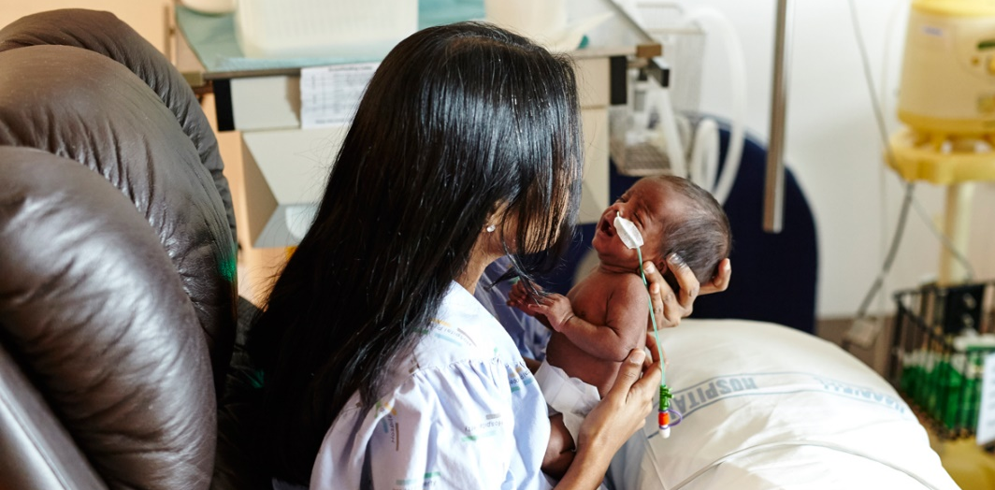
Aim
To evaluate the costs of using dextrose gel as a prophylaxis in infants at risk of neonatal hypoglycaemia compared with standard care
Notes:
Glucose concentration threshold of 2.6 mmol/L.
Incidence data used to model the proportions of at-risk infants who develop neonatal hypoglycemia was extracted from the raw data from the Sugar Babies Study.
Sugar Babies Study - recruited infants at risk of hypoglycemia (late preterm (35-37 weeks of gestation), small (< 10th percentile or < 2500 g), large (> 90th percentile or > 4500 g), mother with diabetes, or other), and used a threshold for definition of hypoglycemia of 2.6 mmol/L.
Consumables include reagents involved in the analysis, which in handheld devices are incorporated into a strip or cartridge, the lancet used to draw blood from the heel of the infant, and capillary tubes used in the collection of the blood sample for analysis by enzymatic-reaction-based glucometers.
Staff time includes an estimate of time for sample collection, and is slightly longer with enzymatic glucometers because blood is collected in a capillary tube before being applied to an analyte cartridge or card attached to the test device, whereas in the non-enzymatic methods blood drawn from a heel prick can be directly applied to a test strip.
Staff costs are based on an hourly rate equivalent to the top of the salary range for a senior registered nurse or midwife (step 5)

Slide 21
Methods
At-Risk Infant
40% Dextrose Gel
Hypoglycaemia
No Hypoglycaemia
Placebo
Cerebral Palsy ONLY
Epilepsy ONLY
Hypoglycaemia
No Hypoglycaemia
Learning Disability ONLY
Severe Learning Disability ONLY
Vision Disorder ONLY
2 Comorbidities
3+ Comorbidities
Notes:
Our decision tree model contains both arms of the Sugar Babies Study (that is, the dextrose gel arm, and the placebo arm), and, is set up to capture the proportions of hypoglycaemic infants who had a single episode versus those that experienced recurrent hypoglycaemia. Both arms received other usual care, so the placebo arm can be thought of as representing “feeding alone”.
72 words, 35 seconds

Slide 22
Methods
- Probabilities, Costs, Utilities
Costs: based on systematic review of annual per-patient direct medical costs
Utilities: based on published catalogues of utilities for chronic childhood conditions
Probabilities: based on systematic review, and dataset analysis of CHYLD and PIANO studies
Challenges
  Paucity of data and heterogeneity of methodologies
  Parameters for comorbid conditions

Slide 23
Agreement Between Applicable Scores for Assessment of Different Studies and Outcomes using ROBINS-I and JBI Tools
Note: overlapping data points have been spread to allow for visibility. The highest data point in an overlapping cluster is the actual value.

Slide 24
Acknowledgements
Supervisors:
  DProf Jane Harding
  Dr Richard Edlin
  Mr Greg Gamble
PhD funding:
  Auckland Medical Research Foundation
Notes:
In summary, the use of dextrose gel resulted in cost savings compared to usual care.
The Sugar Babies Study found that infants who received dextrose gel were less likely to be admitted to NICU for hypoglycaemia, less likely to receive additional dextrose, and less likely to experience treatment failure. In our analysis, most of the difference in the overall costs between the two treatment arms arises from those infants admitted to NICU for hypoglycaemia.
Dextrose gel, on the other hand, contributes only a small proportion of the total costs of care, and hence its use remains the less costly treatment regardless of variations in the cost per dose.
It is noteworthy that our study is based on data from a single, large site. This has advantages and disadvantages – results may vary in scenarios where different treatment protocols, particularly NICU admission protocols, guide or govern practice.
Before this study we knew that…
Dextrose gel is effective, well tolerated by infants, easy to administer including by parents, and is inexpensive.
Further, it is a treatment option which is less likely to interrupt the initiation of breastfeeding, and less likely to involve mother-infant separation.
For these reasons it has been recommended as a ﬁrst-line treatment of late preterm and term infants who develop hypoglycaemia in the ﬁrst 48 h after birth.
We have now shown that in addition to these advantages, dextrose gel is also cost saving when used to treat neonatal hypoglycaemia in late preterm and term infants, and as such should be routinely utilised for the initial treatment of neonatal hypoglycaemia.

Slide 25
Thank you.

