Slide 1
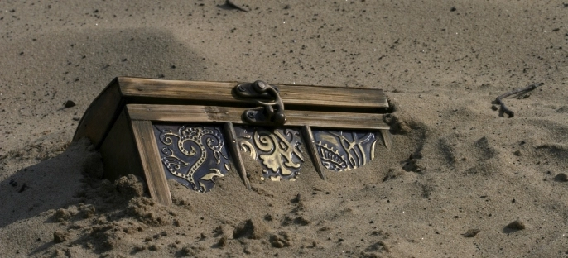
The Scavenger Hunter: One analyst’s experience obtaining cost-of-illness data in New Zealand
Adapt Research
As we build our world we build our minds
Dr Matt Boyd
https://adaptresearchwriting.com
ISPOR NZ Meeting
17 Oct 2018
Notes:
40min session (30min talk?)

Slide 2
Overview
Sources of unit cost data
Databases (often aggregate costs)
Other sources to complement databases
Examples of projects and difficulties
Particular quirks of particular analyses
Suggestion for moving forward

Slide 3
Existing analyses
The most efficient analysis is no analysis
Existing cost-effectiveness, cost-benefit, or budget impact studies may contain the needed data
Inflate or deflate according to CPI, PPP
However:
Costs vs excess costs?
Inclusions/exclusions
New treatments and management pathways
Overall, may not be quite the data you need

Slide 4
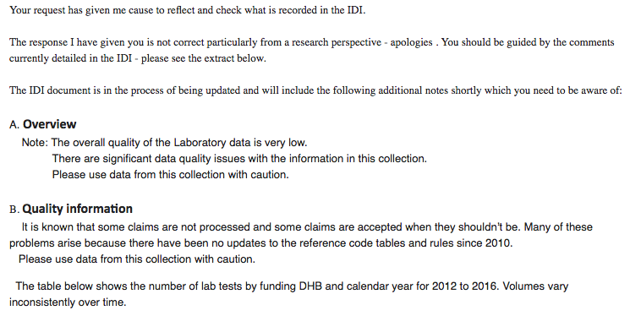
Integrated Data Infrastructure (IDI)

Slide 5
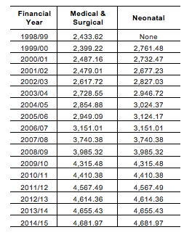
Inpatient

Slide 6
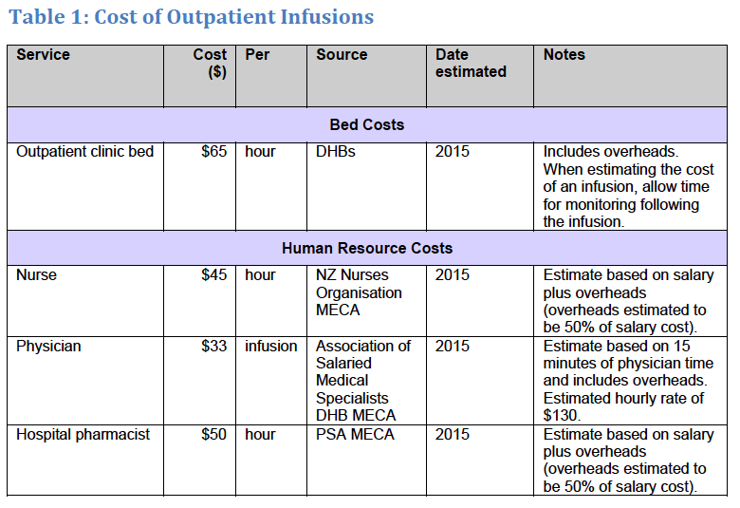
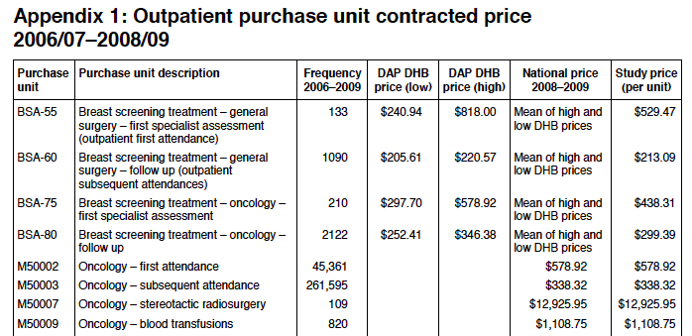
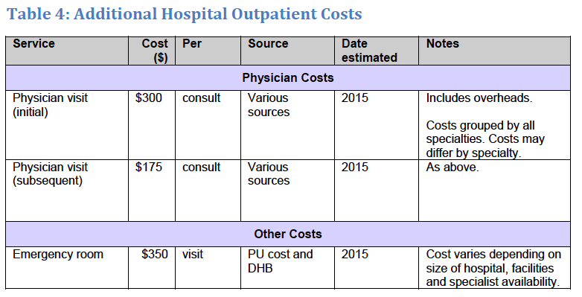
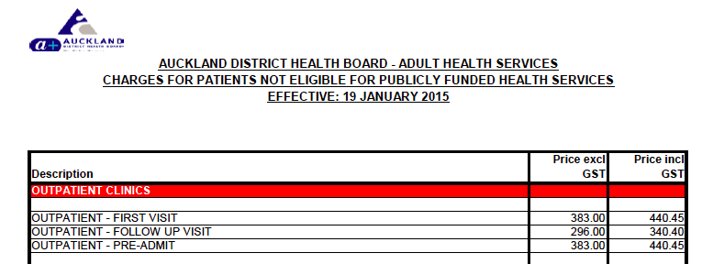
Outpatient
Notes:
- Using the PHARMAC Cost Resource Manual [67]
- However, PHARMAC does not provide a published estimate of the total unit cost for outpatient chemotherapy, so we took the midpoint between ADHB’s cost to non-residents for “follow-up visit chemotherapy” [68] and the estimate for “oral chemotherapy oncology” published in the Ministry of Health’s Price of Cancer report [69].
- This resulted in an estimate for outpatient chemotherapy events of $296 (2016) excluding the cost of pharmaceuticals.
- Given that PHARMAC’s estimated outpatient costs are for all medical specialties combined, the cost of individual haematology clinic appointments or treatments could be higher. There is some evidence for this higher cost of haematology in the Ministry of Health’s Price of Cancer Report [69].

Slide 7
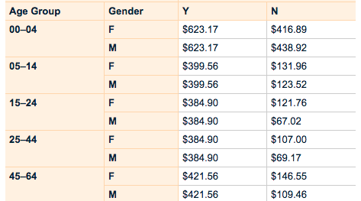
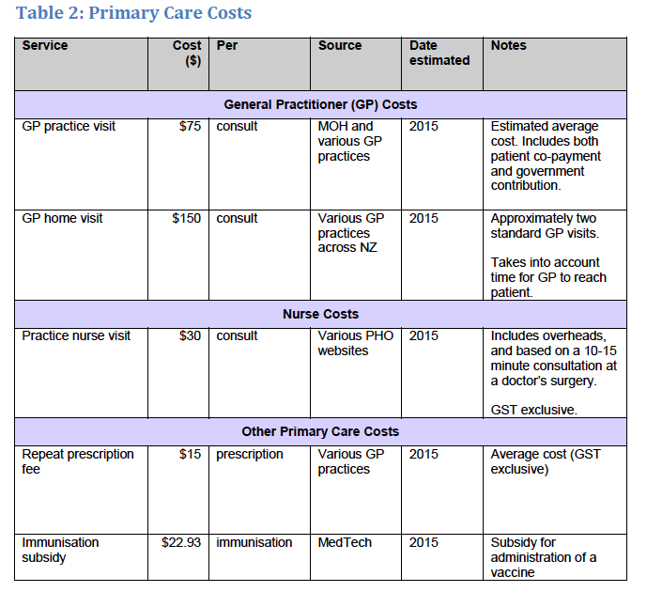
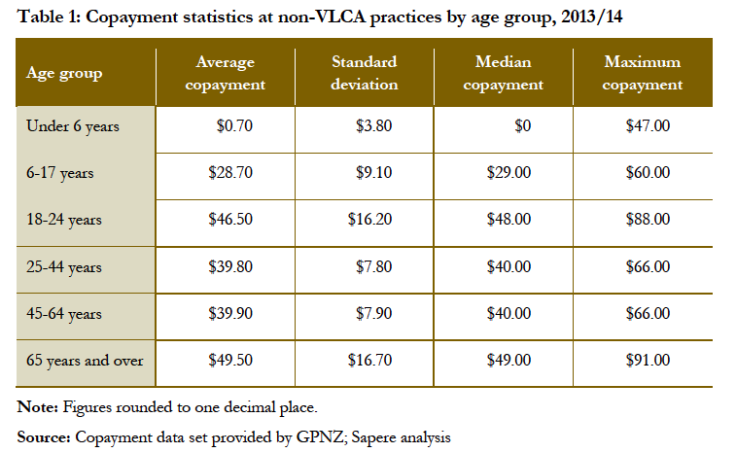
Primary care

Slide 8
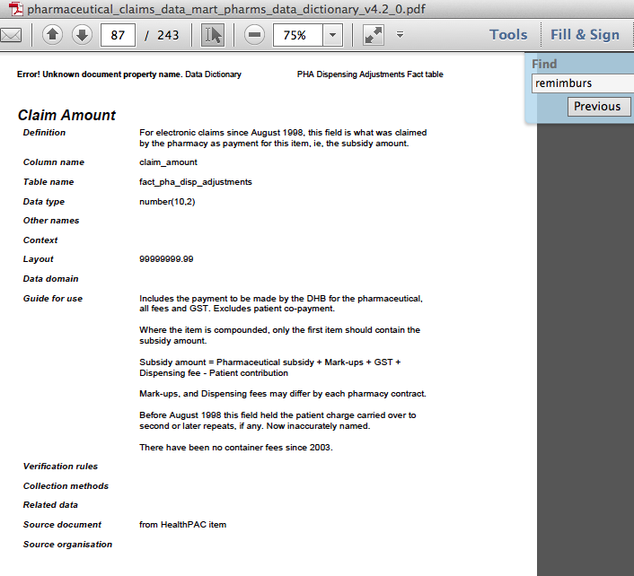
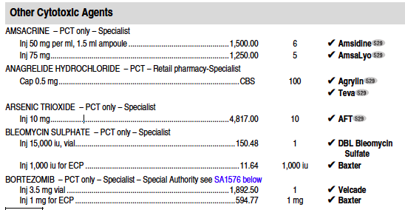
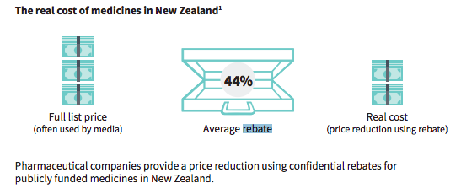
Pharmaceuticals
Notes:
- IDI variable name: ‘moh_pha_remimburs_cost_exc_gst_amt’
Definition: ‘Value reimbursed to the pharmacy, on this dispensing of a prescription item that excludes GST, and can be negative’

Slide 9
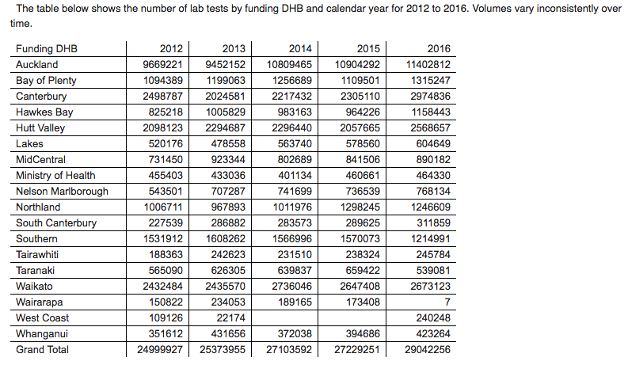
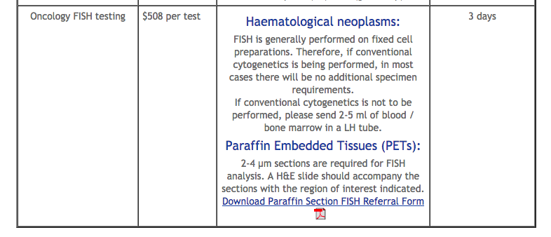
Laboratory tests
Notes:
- CCDHB Wellington regional genetics lab (YEAR 2018)
- Bulk purchase contracts (‘estimated cost’)
- The relevant unit cost was the amount paid to the laboratory by Sector Operations for performing the test, (counting both bulk funded and not bulk funded tests) exclusive of GST
Statistics NZ noted in 2010 that, ‘the recent change in the status of Labs, from a key component of the payment system to data warehouse, has meant that there has been a reduction in the comprehensiveness of the recording of tests.’

Slide 10
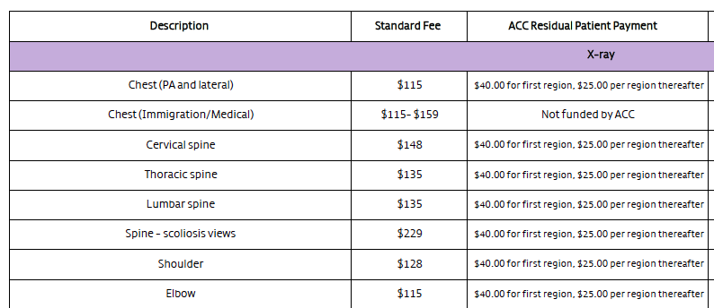
Imaging
Notes:
In the myeloma project at least additional health system costs of up to $2.1 million that may not be captured in the datasets reported above. These additional costs comprise imaging, primary care and laboratory costs
Estimated volumes x unit costs is probably the best we can do

Slide 11
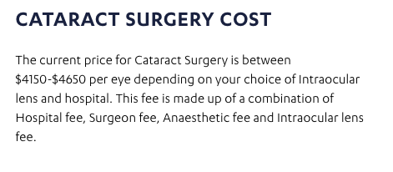
Private sector
Notes:
- I’m not going to dwell on private costs
- Could crudely use a scaling factor

Slide 12
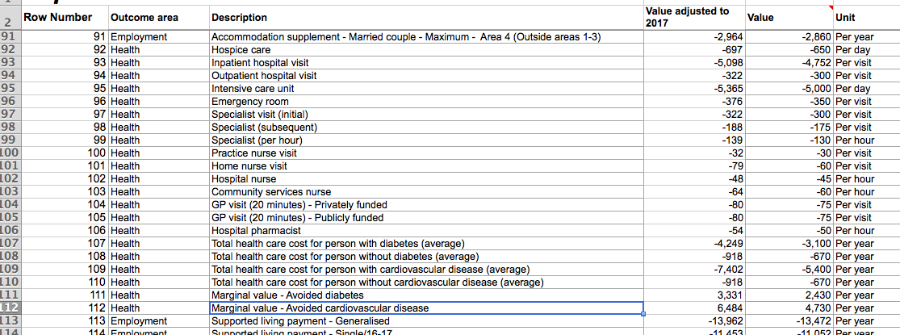
CBAx, societal perspective, patient costs, matched controls…
Notes:
CBAX figures
Patient costs comprise co-payments on GP consultations and pharmaceuticals; reductions in income for patients and caregivers; the costs of travel to and from treatments and appointments; and the value of leisure time.
Societal perspective
We calculated the costs by biological sex (male/female) for an age-matched control population (representing the full New Zealand population) in the same way as the costs for patients with a diagnosis of multiple myeloma.
- Other costs e.g. Blood products (see later in the talk)

Slide 13
Case studies
Notes:
- Will explain some of the difficulties for each case study, what data didn’t exist? How did we solve this? Etc

Slide 14
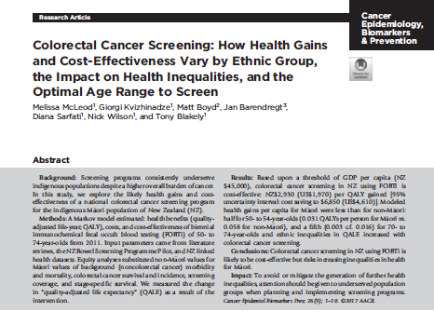
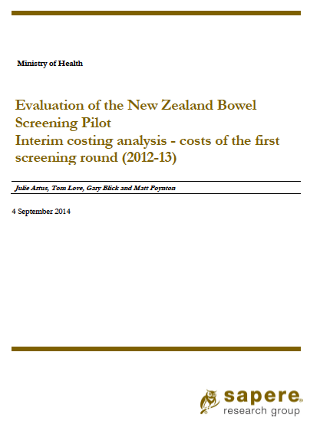
Colorectal cancer screening
Colonoscopy Variable Costs (Sapere interim report p36)
GP Visit |  |  | $60.00
Bowel Prep |  |  | $19.66
Colonoscopist |  |  | $360.46
 | Inhouse salaried |  | $123.08
 | In house contracted |  | $350.00
 | External contracted |  | $1,000.00
Consumables (in house only) |  |  | $100.17
Letter |  |  | $0.68
Histology |  |  | $151.38
Merging previous analyses and adding
uncertainty
Notes:
This example shows how we can build costs from multiple previous analyses into a new analysis (BODE3, BODE3, Sapere, Published articles)
Emphasise the use of uncertainty (especially mean of x3-4 colonoscopy costs and sd)
Cost Data (5 domains)
There are five cost calculations performed to impute costs data to the model.
1. Joe Citizen Costs (from BODE3 existing analysis)
2. Colorectal Cancer Costs (BODE3, existing analysis)
3. Screening Costs (unit costs derived from fixed and variable costs, no economies of scale)
4. Spoiled Kits adjustment ($78,000 estimate from Sapere, translated into per invite cost)
5. Costs of complications from colonoscopy (Bleeding $5263 NZD (low $676, high $8693) / Perforation $17482 NZD (low $5259, high $25918) SD for uncertainty distributions to [(high estimate – low estimate)/3.92])
- We can check back to see if our figures can reproduce the Sapere overall totals (using data for number invited/screened/colonoscopies from page 26 Table):

Slide 15
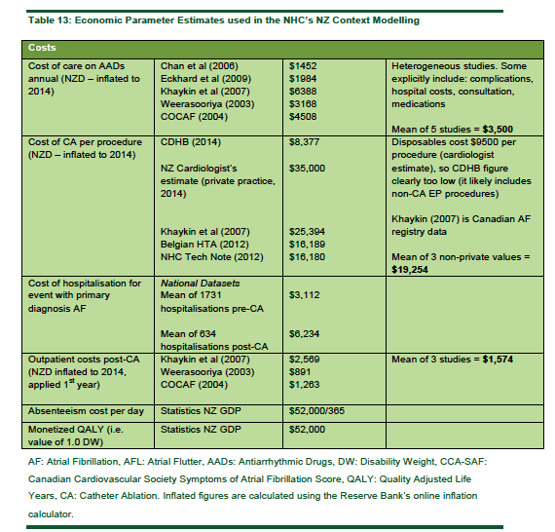
Catheter ablation for AF
Questionable DHB supplied data
Notes:
- DHBs were invited to supply an operational costs breakdown of CA for AF, however most responded that this is difficult to obtain and not routinely recorded.
The CA procedure is expensive. The catheter and materials cost approximately $9500 per procedure (a cryoablation catheter can cost $6500 alone).
A Canadian registry study puts the cost at NZD$25,394 after adjustment for purchasing power parity and inflation(91) and the Belgian HTA estimates NZD$16,189(28) The mean of these three studies puts the cost (in NZD) at $19,254. Analysis of cost weight data in national datasets suggest a cost of between $16,000-$17,000
However, some non-CA for AF procedures will be included in this estimate due to coding ambiguities.
Overall the cost per CA is likely to be approximately $15,000 - $20,000 in the New Zealand public health system.
One New Zealand cardiologist suggested the procedure costs are $35,000 in private practice (Source: personal communication 6/11/2015).
- Long-term success rates are uncertain We have only projected to five years, which is grounded in international data
- Serious complications occur It appears the rate of these is similar to the major complications seen with AADs
- Some patients require multiple ablations, We model a repeat procedure rate
No study has shown reduction in death/stroke We assume no difference in death/stroke and therefore omit these from the model.

Slide 16
Breast cancer
An example of bottom-up costing for infusions
Notes:
- Use as an example of bottom up infusion costing according to PHARMAC’s prices
Key additional sources consulted for costs were:
BODE3 published health system costs for end of life costs
NZ Blood Service for cost of red blood cells
Breast Cancer NZ website for cost of mammography
District health nurse visit costs
https://www.pharmac.govt.nz/assets/pfpa-v2-2-cost-resource-manual.pdf
Some costs are per hour, these are multiplied by duration of infusion (varies by drug, e.g. 30min, 60min) plus monitoring time, we have assumed 2 hours total time and 4 patients per nurse [THESE COME OUT WILDLY LESS THAN THE PoC and ADHB values
Daily subcutaneous injection (5 mcg/kg/day) Injection costs will need to be included if not self-administered (e.g. practice nurse cost $31 per visit)
THE IMPORTANCE OF EXACTLY HOW IT IS DONE: e.g. district nurse in only 10% cases // OR only 1 hour infusion…
Infusion costs from PHARMAC cost resource manual
Blood group test = $20.50 + admin/handling fee $12.50
https://labtests.co.nz/for-patients/all-test-prices
Cost per unit red blood cells = $295.91 sourced from NZ Blood Service’s charge to DHBs

Slide 17
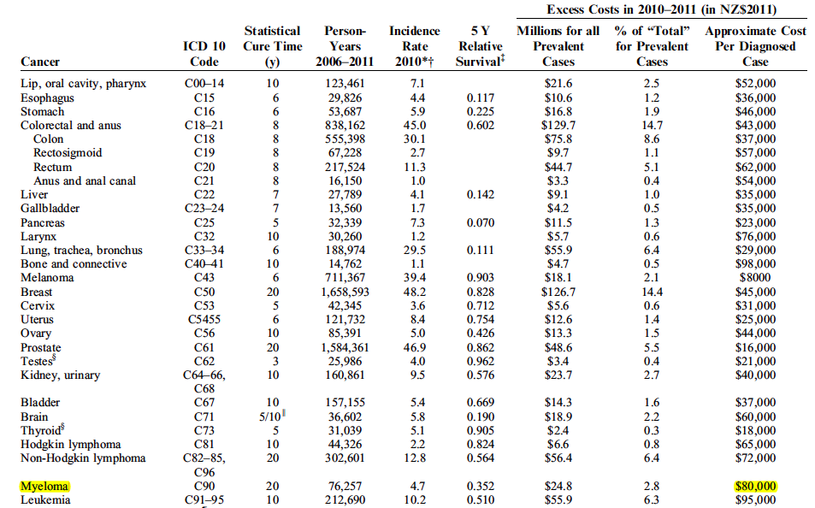
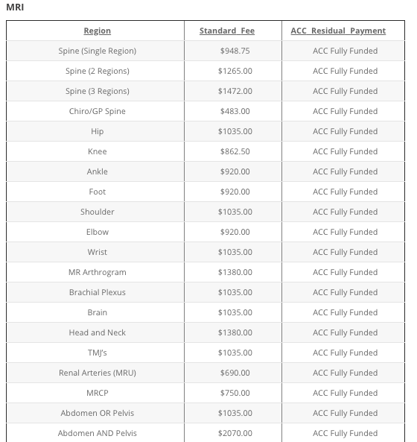
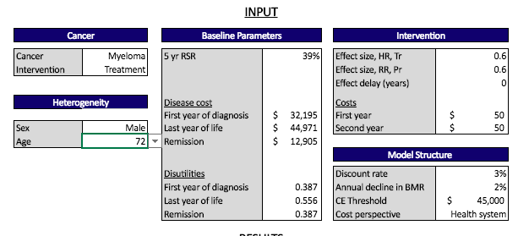
Multiple myeloma
Notes:
I’m not going to reveal any figures since this report isn’t yet published, but some of the findings along the way were interesting from a process point of view
- The importance of double checking
- Imaging costs: At one New Zealand hospital it is standard practice for all new myeloma patients to have a full body MRI and this is likely to become standard practice. Multi body region MRI can cost over $3000 according to private radiology practice price lists in New Zealand
Additional non-laboratory diagnostic tests, if they are undertaken in the community, may not be captured by NMDS or NNPAC. Tests such as echocardiography or lung-function testing will add upwards of $300 per investigation
Additional laboratory costs that we have not counted. For example, the cost per patient of a FISH analysis (assuming 3 probes) is approximately $1500 [71]. If patients who are eligible for stem cell transplant (usually those under 70 years of age) standardly have such analysis, perhaps through a DHB internal hospital laboratory, then this could add up to $300,000 if half of newly diagnosed patients are tested. Laboratory tests processed by DHB internal laboratories are excluded from the laboratory claims dataset.

Slide 18
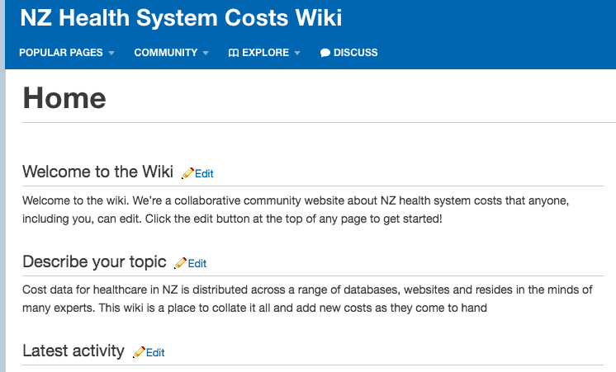
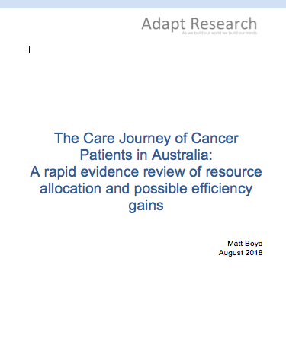
NZ Health System Costs Wiki
Notes:
This is CRITICAL because the following from recent report I did for CaPPRe (drawing on All-Can UK report):
We need more cost-effectiveness studies on real world data
We need cost-effectiveness information in professional guidelines
Probably the biggest return on investment for research funding is research into cost-effectiveness (relatively resource light, and potential for large gains, whether disinvestment or expansion of use)
In order to do these studies we need better data repositories for costs and outcomes
Suzanne Wait of the UK Health Policy Partnership & the All-Can Cancer collaboration

Slide 19
Summary
Don’t believe everything you find or are told (highly niched knowledge, even primary contacts don’t know)
Have an idea of what you expect the numbers to be (and explore any discrepancies)
Seek multiple sources and either select a fit for purpose figure or take a mean (variation is often wild)
If resources allow, model uncertainty (this is often quite high)
Preserve working for future projects (no need to reinvent the wheel each time, start a wiki?)

Slide 20
Thank you
Contact: matt@adaptresearchwriting.com
Adapt Research
As we build our world we build our minds

