Slide 1
The cost-effectiveness of fixed-dose combinations for preventative cardiovascular pharmacotherapy
MPH thesis - Tal Sharrock
BODE³ University of Otago, Wellington
Supervisors: Professor Nick Wilson and Dr Nhung Nghiem

Slide 2
Background & context
CVD disease burden – large impact on health and the health system
Non-adherence to CVD pharmaceuticals is a noted issue
Intended therapeutic effect cannot be realised
Non-adherence is multi-factorial
Doctor-patient relationship
Patient age and education
Perceived need for treatment
Pill burden
Pill Burden
CVD 3-5 pharmaceuticals common
Additional pharmaceuticals for co-existing comorbidities
Fixed-dose combinations (FDCs)

Slide 3
Fixed-dose combinations (FDCs)
Two+ pharmaceuticals with independent action combined in a single pill
Advantages
Improve adherence and clinical efficacy
Simply medication regimens
Decrease dispensing costs and prescription costs (country-specific)
Cheaper than multiple monotherapies medications (country-specific)
Improve tolerability
Disadvantages
Limits dosing flexibility of individual agents
Could be more expensive than multiple monotherapies
Current use of FDC
Infectious diseases – i.e. HIV, Malaria, TB
Pain relief
Fertility control
CVD prevention

Slide 4
CVD FDCs
Largely similar pharmaceutical profile
Single risk factor CVD FDC available since 1950s
i.e. two-agent anti-hypertensives, or two-agent lipid-lowering
Multi-risk factor CVD FDC since 2000s
i.e. two-agent (lipid-lowering and anti-hypertensive agent), polypill
Evidence to suggest that FDCs improve adherence and clinical efficacy resulting in reduced CVD hospitalisations, CVD events and health system savings
Sparse evidence on the cost-effectiveness of CVD FDC
Heterogenous study methods, assumptions, comparisons and costs.

Slide 5
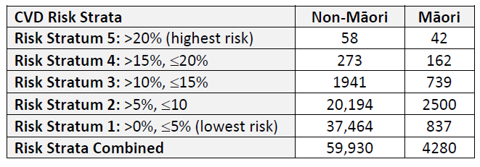
Thesis aim and PICO
To establish the health gains, health system costs and cost-effectiveness of a two-agent CVD prevention pharmaceutical compared to two individual pills by absolute CVD disease strata
Population – New Zealand men aged 60-64 who were alive in 2011 without prevalent CVD and not currently taking CVD pharmaceuticals.
Intervention – FDC amlodipine and atorvastatin (FDC AA)
Comparison – Amlodipine and atorvastatin monotherapy (A+A)
Outcome – Decrease in CVD incidence

Slide 6
CVD
Multi-state life-table

Slide 7
CVD
Multi-state life-table

Slide 8
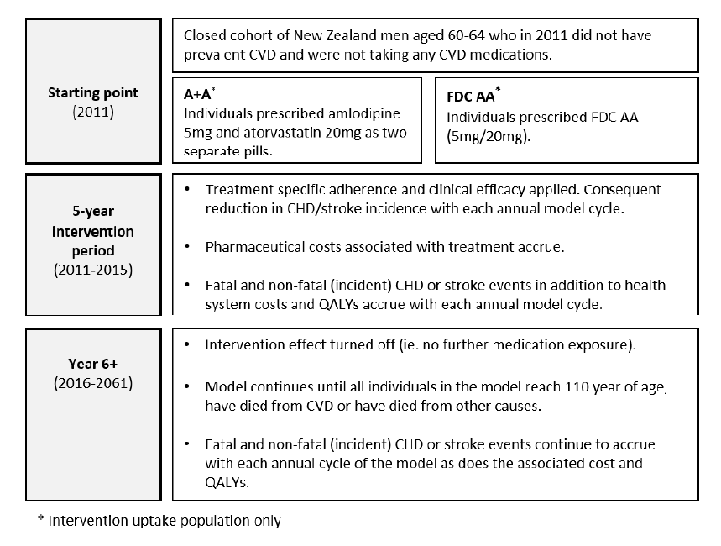
Model key events

Slide 9
Base-case model inputs
Input | FDC AA | A+A |  | Source/Assumption
Uptake | 46% Māori, 38% non-Māori in each CVD strata |  |  | Knight et al 2017 – proportion of people in NZ on either an anti-hypertensive, statin or both
Adherence | Annual decrease of 7.2% | Annual decrease of 12.3% | Annual decrease of 12.3% | Patel et al 2018 - FDC AA vs A+A and CCB/statin – 1 year adherence translated to a uniform decline in adherence over 5-years
Clinical Efficacy | Stroke RR: 0.237 CHD RR: 0.476 | Stroke RR: 0.460 CHD RR: 0.540 | Stroke RR: 0.460 CHD RR: 0.540 | Various - change in SBP and LDL-C from literature applied to standardised risk equations for stroke and CHD Meta-analysis conducted for FDC AA
Cost (pharmaceutical + prescription cost) | One prescription $0.04 per tab (estimated) $178.65 (5-year cost) | Two prescriptions $0.04 per tab (estimated) $284.29.65 (5-year cost) | Two prescriptions $0.04 per tab (estimated) $284.29.65 (5-year cost) | PHARMAC 2017 - Base-case assumed that FDC AA cost the same as the equivalent monotherapy in combination Cost based on 5mg Aml, 20mg Ator

Slide 10
Base-case results
Risk Strata: five-year absolute CVD risk | Non-Māori QALYs gained | Māori QALYs gained | QALYs gained (ethnic groupings combined) | Cost-offsets Ethnic groupings combined (NZ$2011 million) | ICER (NZ$ per QALY) All ethnic groups
A. Overall
Risk Stratum 5: >20% | 1.93 (1.17 to 5.05) | 1.30 (0.97 to 3.77) | 3.23 (1.42 to 7.80) | $-0.009 ($-0.034 to $0.012) | Cost-saving (Cost-saving to $3,940)
Risk Stratum 4: >15%, ≤20% | 6.79 (3.80 to 17.8) | 3.83 (2.96 to 10.9) | 10.6 (4.40 to 26.1) | $-0.049 ($-0.139 to $0.027) | Cost-saving (Cost-saving to $3,570)
Risk Stratum 3: >10%, ≤15% | 32.2 (14.2 to 80.0) | 12.6 (8.04 to 34.4) | 44.7 (15.6 to 105) | $-0.324 ($-0.825 to $0.147) | Cost-saving (Cost-saving to $4,000)
Risk Stratum 2: >5%, ≤10 | 168 (84.1 to 429) | 24.8 (13.6 to 67.6) | 193 (81.5 to 474) | $-2.53 ($-6.25 to $0.822) | Cost-saving (Cost-saving to $3,160)
Risk Stratum 1: >0%, ≤5% | 163 (74.1 to 404) | 4.72 (2.61 to 12.3) | 167 (73.0 to 412) | $-3.41 ($-7.63 to $0.535) | Cost-saving (Cost-saving to $2.12)
Risk Strata Combined | 76.8 (0 to 636) | 9.89 (0 to 49.2) | 86.2 (0 to 386) | $-1.24 ($-6.10 to $0.028) | Costs-saving (cost-saving to $3,570)
B. QALYs / 1,000 people & $ per person who received either pharmaceutical regimen at the start of the model (uptake)
Risk Stratum 5 | 87.6 | 68.8 | 78.1 | -$221 | –
Risk Stratum 4 | 67.2 | 52.5 | 59.5 | -$275 | –
Risk Stratum 3 | 43.7 | 37.9 | 41.5 | -$301 | –
Risk Stratum 2 | 21.9 | 22.0 | 21.9 | -$287 | –
Risk Stratum 1 | 11.4 | 12.5 | 11.4 | -$233 | –
Range represents the 95% uncertainty interval (95%UI) of 2000 Monte Carlo simulations per risk stratum Note: approximately 8% of the 2000 Monte Carlo simulations were excluded from calculations due to the occurrence of negative QALYs. Negative QALYs occurred due to the two pharmaceutical regimens being modelled sequentially and subtracting the respective outputs. Had the regimens been modelled in parallel, negative QALYs would not have been possible QALYs (quality-adjusted life-years): ICER (incremental cost-effectiveness ratio. All numbers rounded to three meaningful digits

Slide 11
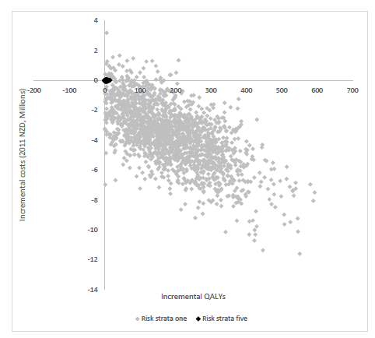
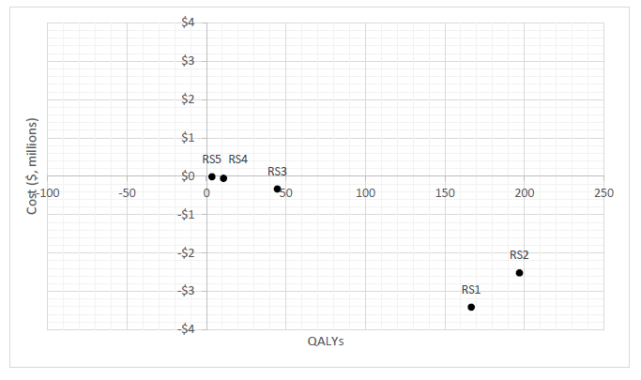
Base-case
results

Slide 12
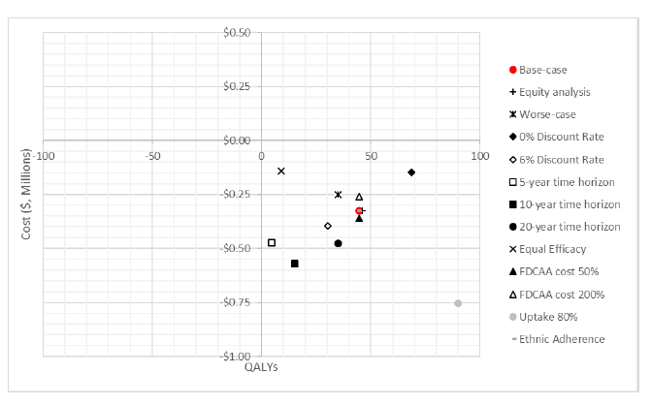
Sensitivity/ scenario analyses results

Slide 13
Strengths/weaknesses and future implications
Strengths
Rich national, longitudinal epidemiological data.
Stratification of absolute CVD risk
Lifetable model reflects population heterogeneity
Knowledge gap in NZ
Limitations
Model baseline
Model population
Uptake and adherence was not stratified by CVD risk
Dichotomous adherence variable
Generalisability
Likely representative of other statin, antihypertensive FDC
Hypothesis generating re a wider population group – future modelling planned
Primary prevention – adherence different for secondary prevention– future research required
NZ specific health system costs limits international generalisability

Slide 14
Conclusions
Switching patients from A+A to FDC AA for the primary prevention of CVD in this population is likely cost-saving
Absolute health gain and cost-savings greatest in lower CVD risk strata (driven by population size)
Per uptake population – health gain is largest in those with the higher CVD/high capacity to benefit – rationale to prioritise targeted treatment?
Equity addressing intervention – similar per capita health gains between Māori and non-Māori in lower risk strata
Efficacy and uptake are major divers of the cost-effectiveness
Relationship to existing literature
First study to look at FDC cost-effectiveness by CVD strata and in a NZ context
Small body of existing literature – primarily on polypills – heterogenous model methods and inputs makes comparison difficult
Looks like a good investment when compared to the average cost-effectiveness in PHARMAC’s annual reports and other primary health interventions analysed by BODE3

Slide 15
Thank you
Any questions?

