Slide 1
Cost Resource Manual
V3.0

Slide 3
Cost Resource Manual
A supplement to the Prescription for Pharmacoeconomic Analysis
Lists prices useful for Health Technology Assessments
A starting point for cost estimates

Slide 4
Cost | Details
Pharmaceutical | Community and hospital pharmaceuticals Pharmacy fees Pharmaceutical administration Pharmacy costs to patients
Primary health care | General practitioner or practice nurse visits
Investigative and diagnostic tests | Diagnostic imaging Pathology tests
Hospital care | Hospital inpatient care Hospital outpatient care (specialist appointments and emergency room visits) Travel and accommodation
Community health services | Palliative care Residential care In-home nursing, personal care and home help Prenatal and postnatal care Disability support services Ambulance

Slide 5
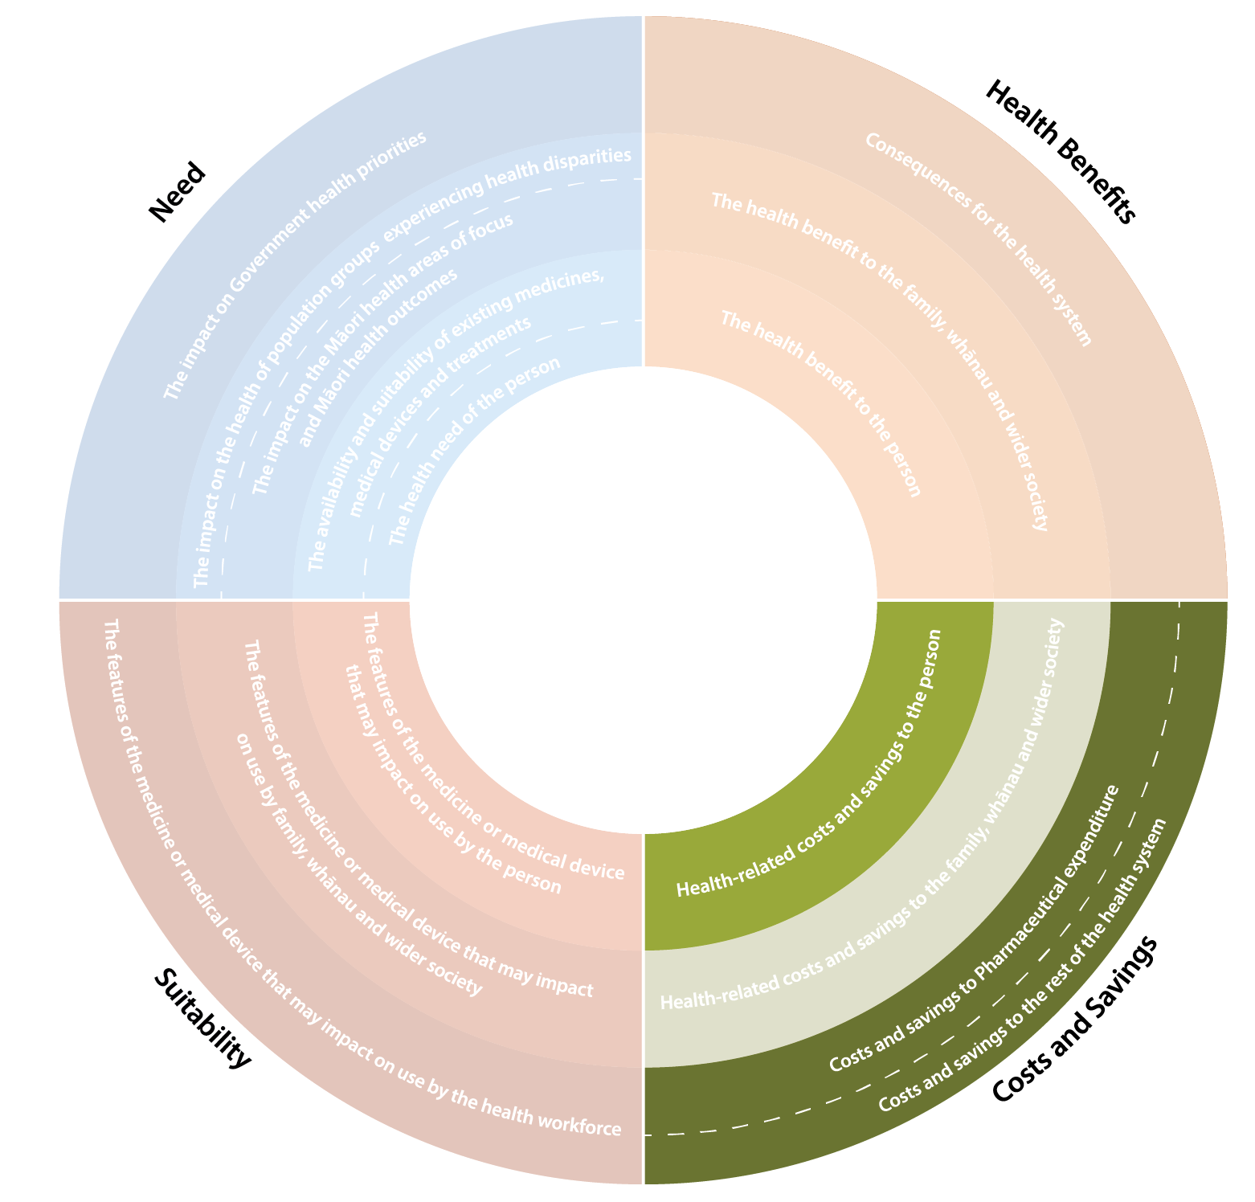
Factors for Consideration: Cost and Savings quadrant

Slide 6
On perspective
Perspective of the Health Sector
Costs to patient
Costs to family, whanau, caregivers
Costs to Vote: Health

Slide 7
Cost of pharmaceutical
Correct dose
Allowing for wastage
Average BMI and body area
Price net of rebates
Future prices

Slide 8
Dispensing
Community pharmacy fees
Patient copayments
Cost of administration (eg infusions)

Slide 9
Primary care costs
= patient fee + any subsidy
Service | Cost ($) | Per | Source | Date of estimate | Notes
General practitioner (GP) costs
GP practice visit | $80 | consult | Various PHOs | 2018 | Estimated average cost. Includes both patient co-payment and government contribution. GST-exclusive.
GP home visit | $170 | consult | Various GP practices across NZ | 2018 | Estimate, includes patient co-payment and government contribution.
Nurse costs
Practice nurse visit | $40 | consult | Various PHO websites | 2017 | Based on a 10-15 minute consultation at a doctor’s surgery. Includes both patient co-payment and government contribution.

Slide 10
Hospital costs
DRG Price paid is preferred to resource-based costing
The 2018/19 cost-weight unit price is $5,068.12.
Service | Cost ($) | Per | Source | Date estimated | Notes
Hospital costs
Hospital medical ward | $1,200 | day | Various hospitals | 2017 | Does not include cost of procedures.
Intensive care unit (ICU) | $5,500 | day | Various | 2017
Human resources
Specialist hourly rate | $150 | hour | Association of Salaried Medical Specialists DHB MECA | 2018 | Estimate based on salary and number of working hours per year, and includes overheads (overheads estimated to be 50% of salary cost). Salary estimated based on MECA agreement.

Slide 11
Service | Cost ($) | Per | Source | Date estimated | Notes
Residential and hospice care
Rest home | $130 | day | Various rest home providers | 2018 | National average costs.
Dementia care | $170 | day | Various | 2018
Hospital care for health of older people | $200 | day | Various | 2018
Hospice care | $690 | day | Average across various hospice providers | 2009 inflation-adjusted to 2018 prices. | Includes overheads. Varies by indication.
Ambulance
Ambulance (emergency) | $680 | event | St John ambulance | 2017 | GST-exclusive charge for non-eligible visitors. The patient part-charge for non-accident-related emergency call-outs is $83 (GST-exclusive).
Ambulance (non-emergency) | $175 | event | St John ambulance | 2017 | Charge for non-emergency ambulance transport not covered by government, for distances less than 35 km. GST-exclusive price.

Slide 12
Issues
GST on patient co-payments
The main reasons for excluding GST are:
consistency
Reasons for including GST in patient costs include:
this is the full out-of-pocket amount patients pay for the service (and comes at an opportunity cost to patients)
Overheads on DHB staff salaries
Inflation adjustment
We now propose no adjustments for inflation.
Consider relative price changes in sensitivity analysis

