Slide 1
: The Burden of Multiple Myeloma in New Zealand ’Preparing for the Scavenger’
Richard Milne
Managing Director, Health Outcomes Associates Ltd
&
Hon. Associate Professor, University of Auckland
ISPOR NZ, Wellington, October 17, 2018

Slide 2
Acknowledgements
Richard Milne^{1,2}, Matt Boyd³, Henry Chan⁴, Barry Milne⁵ & Doney Zhang⁵
1. Health Outcomes Associates Ltd, Auckland
2. School of Pharmacy, University of Auckland
3. Adapt Research, Wellington
4. Waitemata District Health Board, Auckland
5. COMPASS Research Centre, University of Auckland
Funding: Myeloma NZ

Slide 3
Aims
To describe the human and financial burden, treatment and outcomes of multiple myeloma in NZ
To make policy recommendations accordingly

Slide 4
Multiple myeloma
Multiple myeloma, often referred to as myeloma, is a blood cancer that usually starts in the bone marrow and eventually can be found throughout the body.
Sufferers of myeloma experience serious complications including bone and kidney disease, serious infections, and excessive levels of calcium which can lead to confusion, disorientation and weakness.

Slide 5
Multiple myeloma
Management of myeloma in New Zealand typically involves a combination of anti-myeloma medication, chemotherapy, and for younger patients with adequate health, a bone marrow (stem cell) transplant.
Although it is treatable, myeloma is currently incurable, with the disease following a remitting, relapsing course.

Slide 6
Top 13 cancer registrations in 2011-2013
ICD10 & site | Registrations | Ranking
C61 Prostate | 9281 | 1
C50 Breast | 8994 | 2
C43 Malignant melanoma of skin | 6894 | 3
C34 Bronchus and lung | 6075 | 4
C18 Colon | 5949 | 5
C20 Rectum | 2326 | 6
C64 Kidney, except renal pelvis | 1539 | 7
C25 Pancreas | 1507 | 8
C54 Corpus uteri | 1477 | 9
C83 Diffuse non-Hodgkin's lymphoma | 1220 | 10
C16 Stomach | 1143 | 11
C67 Bladder | 1013 | 12
C90 Multiple myeloma and malignant plasma cell neoplasms | 1011 | 13
Source: MoH

Slide 7
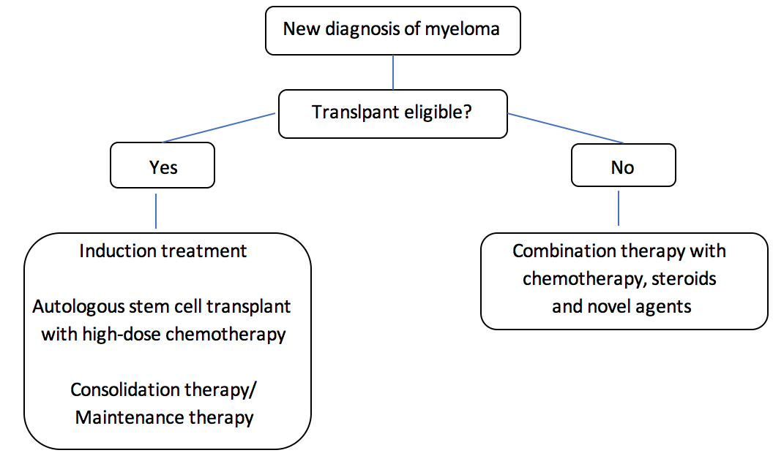

Slide 8
Answerable questions about the burden of myeloma
Incidence and prevalence rates by age, sex, ethnicity, deprivation, region, etc
Comparative incidence rates vs Australia, UK, Canada etc
Comparative survival vs Australia, UK, Canada
Comparison with outcomes for other types of cancer in NZ
Ethic disparities in registration, treatment and survival
Hospital admission and readmission rates
Relationship of survival to funding of new medicines abroad and in NZ
Annual cost to Govt of admissions, ED, GP, pharms, OP appointments etc
Annual cost to society of lost earnings (patients and caregivers)
Annual cost to Govt of lost tax plus social welfare benefits
Therapies: surgical and medical, uptake by region wrt survival
Quality of life, by stage, and DALYs
… etc

Slide 9
Methodologies
National Data Collections used in these analyses:
NZ Cancer Register (ICD10 C90, 2004-2016)
NZ Mortality Register
National Minimum Dataset (NMDS)
National Pharmaceutical Collection
Dept of Internal Affairs Collection
Datasets were linked at patient level by unique NHI
Non residents were excluded (<0.5%)
Analyses were performed on Stata v.12 and Excel 2010
Cost were generated from multiple sources by ‘THE SCAVENGER’

Slide 12
Numbers of new registrations and incidence rates in 2012-2016
 | Māori | Pacific | Asian | Eur/Other | Total
Total
Registrations | 194 | 111 | 81 | 1478 | 1864
Annual incidence rate | 5.53 | 7.59 | 2.93 | 9.86 | 8.20
Age std incidence rate | 7.19 | 10.13 | 3.51 | 5.05 | 5.19
Male
Registrations | 104 | 55 | 46 | 909 | 1114
Annual incidence rate | 6.06 | 7.61 | 3.41 | 12.32 | 9.98
Age std incidence rate | 8.53 | 10.71 | 4.26 | 6.65 | 6.64
Female
Registrations | 90 | 56 | 35 | 569 | 750
Annual incidence rate | 5.02 | 7.58 | 2.47 | 7.48 | 6.49
Age std incidence rate | 6.13 | 9.55 | 2.83 | 3.61 | 3.92

Slide 13
Prevalence (= number alive now)
 | Female |  | Male |  | Total
 | Registrations | Deaths | Registrations | Deaths | Registrations | Deaths
# registrations and deaths in 1990 | 80 | 22 | 92 | 35 | 172 | 57
# registered and died in 1990-2016 | 2946 | 2231 | 4190 | 3131 | 7136 | 5362
Expected new cases and deaths in 2017* | 175 | 43 | 255 | 64 | 430 | 107
Expected new cases and deaths in 2018* | 191 | 40 | 274 | 58 | 465 | 98
# registrations and deaths in 1990-2018 | 3312 | 2314 | 4719 | 3253 | 8031 | 5568
Prevalence at December 2018 | 998 |  | 1466 |  | 2463
Prevalence rate per 100,000 | 40.3 |  | 70.3 |  | 54.0
* Based on mean annual change since 2012

Slide 14
District Health Board | Total (2012-2016) | Percent of cases | Incidence rate
Northland | 109 | 5.8 | 13.07
Midcentral | 106 | 5.7 | 12.41
Whanganui | 37 | 2.0 | 11.84
Wairarapa | 24 | 1.3 | 11.21
South Canterbury | 30 | 1.6 | 10.32
Southern | 139 | 7.5 | 8.94
Bay of Plenty | 96 | 5.2 | 8.77
Taranaki | 50 | 2.7 | 8.70
West Coast | 14 | 0.8 | 8.53
Canterbury | 218 | 11.7 | 8.44
Nelson Marlborough | 60 | 3.2 | 8.36
Waikato | 160 | 8.6 | 8.31
Hawkes Bay | 64 | 3.4 | 8.05
Waitemata | 224 | 12.0 | 7.92
Lakes | 38 | 2.0 | 7.29
Hutt Valley | 52 | 2.8 | 7.24
Counties Manukau | 177 | 9.5 | 6.93
Auckland | 158 | 8.5 | 6.62
Tairawhiti | 15 | 0.8 | 6.35
Capital and Coast | 93 | 5.0 | 6.24
Total | 1864 | 100.0 | 8.23

Slide 15
DHBs by Cancer Network Region
Name | Region
Northland | Northern
Waitemata | Northern
Auckland | Northern
Counties Manukau | Northern
Waikato | Midland
Lakes | Midland
Bay of Plenty | Midland
Tairawhiti | Midland
Taranaki | Central
Hawke's Bay | Central
Midcentral | Central
Whanganui | Central
Capital and Coast | Central
Hutt | Central
Wairarapa | Central
Nelson Marlborough | Southern
West Coast | Southern
Canterbury | Southern
South Canterbury | Southern
Southern | Southern

Slide 16
New registrations by cancer network region
Region | 2012 | 2013 | 2014 | 2015 | 2016 | Total | Mean incidence*
Central | 72 | 59 | 78 | 66 | 87 | 362 | 7.30
Midland | 72 | 72 | 83 | 64 | 82 | 373 | 9.87
Northern | 122 | 123 | 140 | 149 | 134 | 668 | 7.77
Southern | 84 | 103 | 78 | 101 | 95 | 461 | 8.68
Total | 350 | 357 | 379 | 380 | 398 | 1,864 | 8.23
*New registrations per 100,000 population

Slide 18
Deaths and mortality from myeloma
 | Māori | Pasifika | Asian | Eur/Other | Total
All cause deaths | 95 | 52 | 27 | 718 | 892
Mean mortality rate per 100,000 | 2.75 | 3.59 | 1.01 | 4.83 | 3.98
Age std mortality rate* | 3.81 | 3.20 | 1.29 | 2.22 | 2.33
 | Male | Female | Total
All cause deaths | 521 | 371 | 892
Mean mortality rate | 4.73 | 3.25 | 3.98
Age std mortality* | 2.99 | 1.77 | 2.33
*WHO population

Slide 19
New registrations in 2012-2016 by priorised ethnicity
 | NZDep13 quintile
Ethnic group | 1-2 | 3-4 | 5-6 | 7-8 | 9-10
Māori | 5.7% | 8.8% | 18.0% | 25.8% | 41.8%
Pasifika | 6.3% | 9.9% | 7.2% | 23.4% | 53.2%
Asian | 19.8% | 32.1% | 12.3% | 19.8% | 16.0%
Eur/other | 21.0% | 19.7% | 20.2% | 23.7% | 15.3%
Total | 18.5% | 18.5% | 18.9% | 23.8% | 20.3%

Slide 24
Usage of novel therapies
 | Northern | Central | Midland | Southern | Total
Numbers of patients
Bortezomib + ASCT | 141 | 68 | 78 | 104 | 391
ASCT not bortezomib | 2 | 0 | 0 | 3 | 5
Bortezomib not ASCT | 122 | 68 | 57 | 75 | 322
Neither | 81 | 54 | 28 | 50 | 213
Total | 346 | 190 | 163 | 232 | 931
Percent of patients
Bortezomib + ASCT | 40.8% | 35.8% | 47.9% | 44.8% | 42.0%
ASCT not bortezomib | 0.6% | 0.0% | 0.0% | 1.3% | 0.5%
Bortezomib not ASCT | 35.3% | 35.8% | 35.0% | 32.3% | 34.6%
Neither | 23.4% | 28.4% | 17.2% | 21.6% | 22.9%
ASCT as % of bortezomib patients | 53.6% | 50.0% | 57.8% | 58.1% | 54.8%

Slide 25
Total quantity of bortezomib dispensed in May 2011 to June 2016, by region.
* 2016 is for Jan - June

Slide 26
Overall and cause-specific survival before and after bortezomib was funded in May 2011.

Slide 28
Multivariate analysis
Prognostic factor | Hazard Ratio | Std. Error | z | P>z | +95%CI | -95%CI
ASCT | 0.662 | 0.091 | -3.000 | 0.003 | 0.505 | 0.866
BORT | 0.740 | 0.057 | -3.890 | 0.000 | 0.636 | 0.861
Age at registration | 1.058 | 0.004 | 13.290 | 0.000 | 1.049 | 1.066
NZDep2013 | 1.098 | 0.029 | 3.560 | 0.000 | 1.043 | 1.155
Region | 1.117 | 0.033 | 3.720 | 0.000 | 1.054 | 1.184

Slide 29
Healthcare system costs in 2016
Region | Admissions | Outpatients | ED | Laboratory tests | Pharms | TOTAL
New Zealand | $14.9 | $4.8 | $0.4 | $0.9 | $31.1 | $56.5
Central | $3.0 | $1.07 | $0.09 | $0.09 | $5.51 | $10.8
Midland | $3.4 | $0.71 | $0.08 | $0.15 | $5.42 | $10.4
Northern | $5.0 | $1.77 | $0.14 | $0.54 | $12.29 | $21.3
Southern | $3.5 | $1.29 | $0.09 | $0.09 | $7.78 | $13.9
Other | $0.0 | $0.00 | $0.00 | $0.00 | $0.07 | $0.1

Slide 30
Main points
Incidence is increasing
Mortality is stable
Prevalence in 2018 about 2400
Survival at 1mth, 3y, 5y has improved since 2004
Step improvement in survival since bortezomib was funded
Uptake of bortezomib and ASCT is good and could be better
Impact of novel pharms and stem cell transplant by age group
High costs for MM patients in 2016 compared to age/sex matched general population
Admissions
Pharms
Labs
ED/OP

Slide 31
Policy recommendations
Identify the causes for regional differences in uptake of novel therapies and survival across regions.
Put in place systems that facilitate collaboration and comparison of outcomes between centres
Start to include clinical and genetic information in the NZCR
Find better ways to ensure that medication is delivered more efficiently and more cost effectively
district nurse administration
partnering hospitals with local general practices
providing equipment for patient self-administering at home.
Resolve capacity issues for infusions.
Provide better access for first-line treatment with novel therapeutic agents
this is most likely to lead to improved life-expectancy, less time off work, and deferral of residential care and end-of-life costs.
Work collaboratively with pharmaceutical companies in conducting clinical trials of novel therapies.

Slide 32
Govt healthcare costs in 2016 Myeloma vs general population, Age and sex matched 1800 patients
Obtained via the IDI
Introducing the Scavenger!

